Slide 1
Spark & DSX Overview
Introduction to Apache Spark for Data Engineers, Data Scientists, and Developers

Slide 2

What is data science?
Notes:
It Is an interdisciplinary field
It sits at the intersection of quite a few skill sets
While Machine learning & Data Science are closely related, data science differentiates itself by also requiring domain knowledge.
For example, you may have some background in genomics and when presented with such a set, you apply what you know to convert your data into something which machine learning models can use, we will see a small example of this later on during our labs
And while it is indeed a wide set of skills to be mastered, good news for us is that a lot of tools out there abstract away all the nitty gritties of these skills
All you need to know is the uses of each and how and where to apply them. We will see a some examples later on in our hands on lab

Slide 3
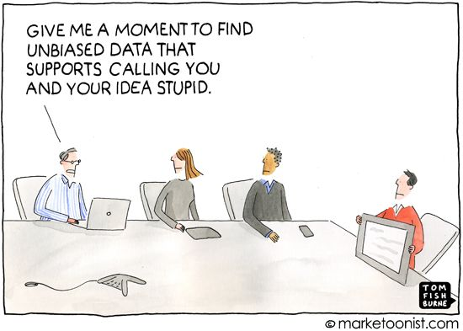
Why do we need it?
We need Data Science to make valid, objective inferences from data, free from human bias – KDNuggets
Notes:
We need data science to be able to answer business questions
You want to be able to know if the KPIs you have defined for your business and are looking good are a result of your marketing efforts or some external factors.
More concisely, you want to be able to make decisions based on something solid and not just because your gut says so.
KDNuggets

Slide 4
What do we need to practice data science?
Technology / Technology stack
Platform / Tool(s)
Data
Expertise
Notes:
I am convinced that I need to apply data science in my organization, now what I have to do?
Well, you will need a few things
1) Technology or a many time a set of technologies grouped together, you will need some for cleaning your data, for applying data science models and then to visualize your results.
2) you need platform/ tools (it can be a place you want to write SQL queries, or other code, share results, you might need version control). You will also need something to be able to share and display results to biz folks
3) You need data (flat files/ right out of your DB, processed/semi-processed, streaming). Mostly importantly, you need proper connectors to these data stores.
4) Lastly you need expertise (both to handle your tools and to work your technology stack)

Slide 5
What do we need to practice it?
Technology / Technology stack
Spark
Platform / Tool(s)
Data Science Experience (contains the set of tools useful for a team)
Data
Data Connect
Expertise
Hands on Labs
Notes:
We will work be going over spark basics and some hands on sessions.
The expertise is really going to be transferable (since the skills you learn are mostly open source) with spark + jupyter+ some python libraries

Slide 6

Technology
What is spark?
Why spark?
IBM’s contributions
Spark Internals
Notes:
How many of you are already using spark?
How many of you use jupyter/ rstudio?

Slide 7

Spark is an open source
in-memory application framework for
distributed data processing and
iterative analysis
on massive data volumes
“Analytic Operating System”
Notes:
Spark is an open source project which came out of UC Berkeley’s AMPLAB, now called the “RiseLab”
It is an in memory distributed processing engine
It is designed for heavy workloads
At IBM, we like to call it the “Analytic operating system”

Slide 8
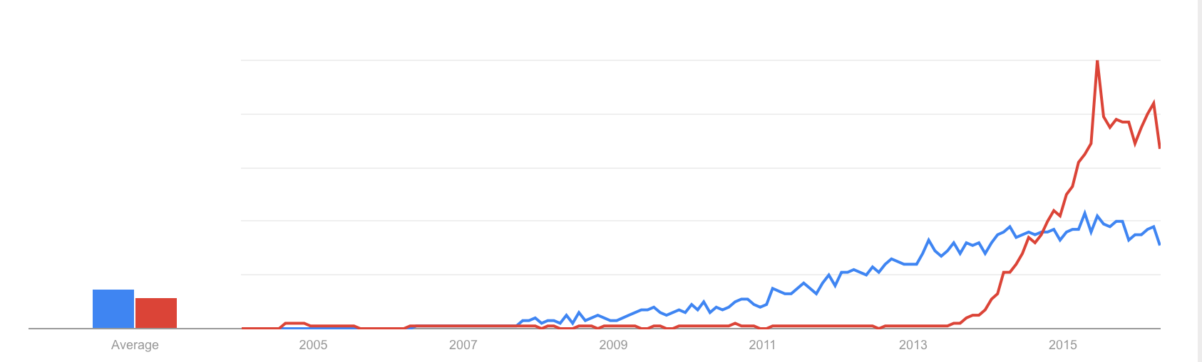
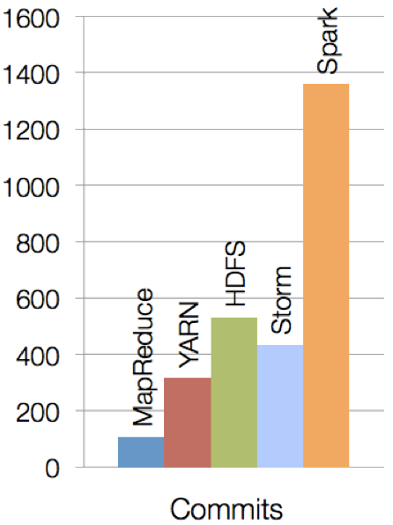
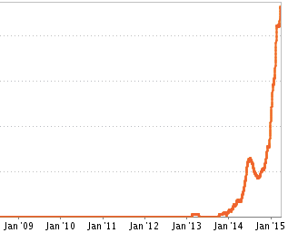
Spark is new, but evolving quickly and has gained tremendous traction in a short amount of time
Spark is one of the most active open source projects
Hadoop vs Spark (Google Trends)
Spark Job Trends (Indeed.com)
Notes:
It is one of the most active open source projects
In terms of adoption, it has seen a meteoric rise v/s Hadoop which is still enjoying a rise but a steady one
Also reflects in job trends, number of openings which need spark expertise (also on a rise)

Slide 9





Key reasons for interest in Spark
Performant
Productive
In-memory architecture greatly reduces disk I/O
Anywhere from 20-100x faster for common tasks
Concise and expressive syntax, especially compared to prior approaches
Single programming model across a range of use cases and steps in data lifecycle
Integrated with common programming languages – Java, Python, Scala
New tools continually reduce skill barrier for access (e.g. SQL for analysts)
Works well within existing Hadoop ecosystem
Large and growing community of contributors continuously improve full analytics stack and extend capabilities
Leverages existing investments
Improves with age
Notes:
Note that this is a marketing slide. We can correct some of the perception it gives.
Performance:
The 20-100x faster is not qualified: faster than what?
It turns out that this information comes from the home page of the Apache Spark site. It is compared to Hadoop MapReduce.
We should not set this type of expectation since this is one very specific benchmark that is highly iterative.
We don’t need to sell Spark. What is important is to demonstrate our commitment to Spark. It would be much better to
Tell customers that they should see performance improvements compared to MapReduce but never support those multipliers.
Productivity:
One of the reason for increased productivity is the fact that Spark comes with a set of classes and methods that
allow a programmer to get to the desired result faster. MapReduce did not have those pre-built capabilities.
Note that having pre-built capabilities does not remove the learning curve to become competent with the product.
Finally, mentioning “SQL” as part of new tools speaks to the state of open-source projects: they are mainly for technologists (programmers). A lot more needs to be done to make it easy to use.
Leverage existing investment: You can still use your Hadoop (BigInsights) environment.
Improves with age:
Spark is the largest and most active Apache project. As we’ll see later, the product has evolved quickly and will
certainly continue to do so for quite a while.

Slide 10










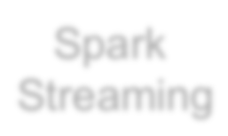
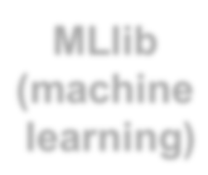

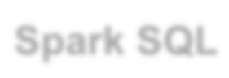







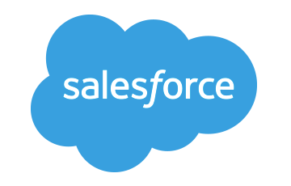












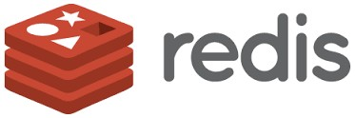
Spark Ecosystem
executes SQL statements
performs streaming analytics using micro-batches
common machine learning and
statistical algorithms
distributed graph processing framework
Execute R
Statistical code against Spark Code
Spark SQL
Spark Streaming
MLlib (machine learning)
GraphX (graph)
SparkR
general compute engine, handles
distributed task dispatching,
scheduling and basic I/O functions
Spark Core Engine
large variety of data sources and formats can be
supported, both on premise or cloud
BigInsights (HDFS)
Cloudant
dashDB
SQL DB
Object Storage
…many others
IBM CLOUD
OTHER CLOUD
CLOUD APPS
ON-PREMISE
Notes:
Spark is completely agnostic to data sources
Bring your data and it will work just fine

Slide 11










Libraries Usage¹
Spark SQL
Spark Streaming
MLlib
Machine Learning
§ SparkSQL − 69%
GraphX
Graphing
§ DataFrames − 62%
§ Spark Streaming − 58%
§ MLlib/GraphX − 58%
Spark Core
75% of users use more than one component

Slide 12
Spark Programming Languages
Scala
Functional programming
Scala compiles into Java byte code
Language | 2014 | 2015 | 2016
Scala | 84% | 71% | 65%
Java | 38% | 31% | 29%
Python | 38% | 58% | 62%
R | unknown | 18% | 20%
§ Java
– New features in Java 8 makes for more compact coding (lambda expressions)
Python
Most widely used API with Spark today
R
Functional programming language used to create and manipulate functions
Notes:
The hands on lab today will be using pyspark

Slide 13
IBM is all-in on Spark
"It's like Spark just got blessed by the enterprise rabbi."
Contribute to the Core
Launch Spark Technology Cluster (STC), 300 engineers
Open source SystemML
Partner with databricks
Ben Horowitz,
Andreessen Horowitz
Foster Community
Infuse the Portfolio
Integrate Spark throughout portfolio
3,500 employees working on Spark-related topics
Spark however customers want it – standalone, platform or products
Educate 1M+ data scientists and engineers via online courses
Sponsor AMPLab, creators and evangelists of Spark
Notes:
We are all in on spark
We have a center in San Francisco where our engineers are dedicated to contributing to spark, they do not work on any other project
We aim to hire about 300 engineers, we are many 70 as of now
We have also developed and open sourced SystemML which is a machine learning library
We also offer sponser AMPLab where spark was born and we are continuing to invest in RiseLab
There is also free education on big data university for spark and other big data courses
And lastly, spark is a component in a lot of our products and the number is rising, we also offer it on a standalone basis

Slide 14



Spark Tech Center (STC): IBM’s Commitment to Spark
1.5 Years
25,600 Spark LOC
606 Spark JIRAs
253 SystemML JIRAs
64 Speakers at events
… and all that with 1 Team

Slide 15
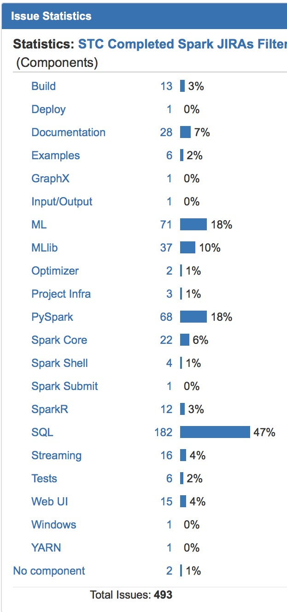
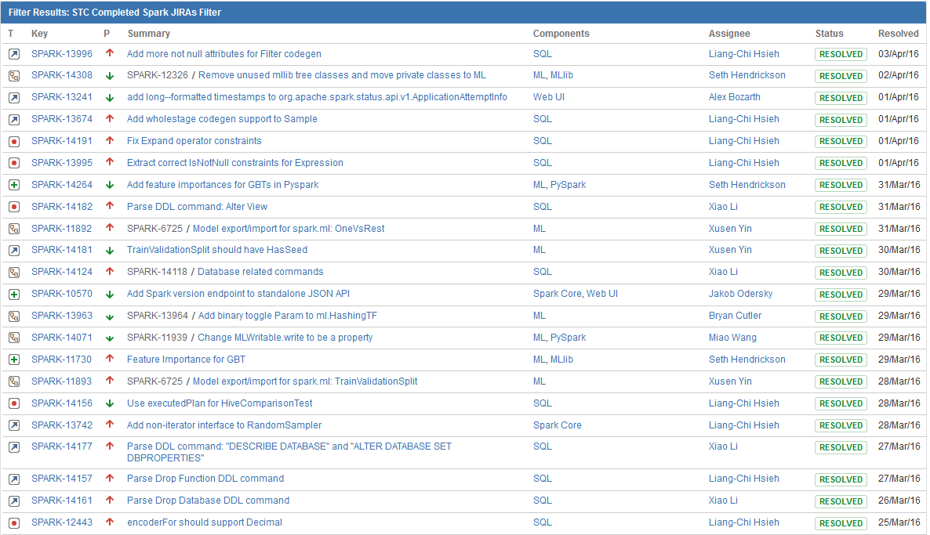
IBM driving SQL and Machine Learning innovation..
http://www.spark.tc/blog/

Slide 16
Comparison of Company Contributions in Spark 2.0
Databricks is active across the board, but especially in Spark SQL
IBM is prominent in every component, but dominates in Spark ML, PySpark and SparkR

Slide 17
Spark Terminology
Context (Connection):
Represents a connection to the Spark cluster. The Application which initiated the context can submit one or several jobs, sequentially or in parallel, batch or interactively.
Driver (Coordinator agent)
The program or process running the Spark context. Responsible for running jobs over the cluster and converting the App into a set of tasks
Job (Query / Query plan):
A piece of logic (code) which will take some input from HDFS (or the local filesystem), perform some computations (transformations and actions) and write some output back.
Stage (Subplan)
Jobs are divided into stages
Tasks (Sub section)
Each stage is made up of tasks. One task is executed on one partition (of data) by one executor
Executor (Sub agent)
The process responsible for executing a task on a worker node
Notes:
Context – Handle to your cluster, each application will have its own context. At a given point of time, there can be several contexts on a cluster
Driver – Works hand in hand with the context, it is a program which runs on the master node and is responsible for generating an execution plan
Job – a single piece of code which you will submit to the cluster (and this job will be divided by the driver into smaller pieces to be run on worker nodes)
Stage – a part of the job
Tasks - the most atomic piece of code, this runs on the worker nodes, each worker node will have a single task for the given job.

Slide 18
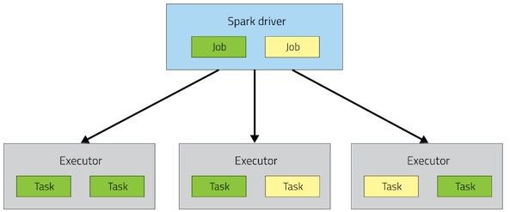
Spark Architecture
Application

Slide 19
A Spark application is initiated from a driver program
Each Spark application runs as a set of processes coordinated by the Spark context object (driver program)
– Spark context connects to Cluster Manager (standalone, Mesos/Yarn)
Spark context acquires executors (JVM instance) on worker nodes
Spark context sends tasks to the executors
Worker Node
Executor
Cache
Task
Task
Driver Program
Cluster Manager
App
SparkContext
Worker Node
Executor
Cache
Task
Task

Slide 20
Resilient Distributed Datasets
RDD is a distributed collection of Scala/Python/Java objects of the same type:
Strings
Integers
(key, value) pairs
class Java/Python/Scala objects
RDDs are immutable
Modifications create new RDDs
Physically distributed across cluster, but manipulated as one logical entity:
Spark will “distribute” any required processing to all partitions where the RDD exists and perform necessary redistributions and aggregations as well.
Example: Consider a distributed RDD “Names” made of names
Partition 1
Partition 2
Partition 3
Names
Mokhtar Jacques Dirk
Cindy Dan Susan
Dirk Frank Jacques

Slide 21
Resilient Distributed Datasets
Suppose we want to know the number of names in the RDD “Names”
User simply requests: Names.count()
Spark will “distribute” count processing to all partitions so as to obtain:
Partition 1: Mokhtar(1), Jacques (1), Dirk (1) è 3
Partition 2: Cindy (1), Dan (1), Susan (1) è 3
Partition 3: Dirk (1), Frank (1), Jacques (1) è 3
Local counts are subsequently aggregated: 3+3+3=9
To lookup the first element in the RDD: Names.first()
To display all elements of the RDD: Names.collect() (careful with this)
Names Partition 2
Partition 1
Partition 3
Mokhtar Jacques Dirk
Cindy Dan Susan
Dirk Frank Jacques

Slide 22
RDDs
Two types of operations
Transformations
Actions
Fault tolerance
If data in memory is lost it will be recreated from lineage

Slide 23
Code Execution (1)
// Create RDD
val quotes = sc.textFile("hdfs:/sparkdata/sparkQuotes.txt")
// Transformations
val danQuotes = quotes.filter(_.startsWith("DAN"))
val danSpark = danQuotes.map(_.split(" ")).map(x => x(1))
// Action danSpark.filter(_.contains("Spark")).count()
// Create RDD
val quotes = sc.textFile("hdfs:/sparkdata/sparkQuotes.txt")
// Transformations
val danQuotes = quotes.filter(_.startsWith("DAN"))
val danSpark = danQuotes.map(_.split(" ")).map(x => x(1))
// Action danSpark.filter(_.contains("Spark")).count()
File: sparkQuotes.txt
DAN Spark is cool BOB Spark is fun
BRIAN Spark is great DAN Scala is awesome BOB Scala is flexible

Slide 24
Code Execution (2)
// Create RDD
val quotes = sc.textFile("hdfs:/sparkdata/sparkQuotes.txt")
// Transformations
val danQuotes = quotes.filter(_.startsWith("DAN"))
val danSpark = danQuotes.map(_.split(" ")).map(x => x(1))
// Action danSpark.filter(_.contains("Spark")).count()
File: sparkQuotes.txt
RDD: quotes
DAN Spark is cool BOB Spark is fun
BRIAN Spark is great DAN Scala is awesome BOB Scala is flexible

Slide 25
Code Execution (3)
// Create RDD
val quotes = sc.textFile("hdfs:/sparkdata/sparkQuotes.txt")
// Transformations
val danQuotes = quotes.filter(_.startsWith("DAN"))
val danSpark = danQuotes.map(_.split(" ")).map(x => x(1))
// Action danSpark.filter(_.contains("Spark")).count()
// Create RDD
val quotes = sc.textFile("hdfs:/sparkdata/sparkQuotes.txt")
// Transformations
val danQuotes = quotes.filter(_.startsWith("DAN"))
val danSpark = danQuotes.map(_.split(" ")).map(x => x(1))
// Action danSpark.filter(_.contains("Spark")).count()
File: sparkQuotes.txt
RDD: quotes
RDD: danQuotes
DAN Spark is cool BOB Spark is fun
BRIAN Spark is great DAN Scala is awesome BOB Scala is flexible

Slide 26
Code Execution (5)
// Create RDD
val quotes = sc.textFile("hdfs:/sparkdata/sparkQuotes.txt")
// Transformations
val danQuotes = quotes.filter(_.startsWith("DAN"))
val danSpark = danQuotes.map(_.split(" ")).map(x => x(1))
// Action danSpark.filter(_.contains("Spark")).count()
// Create RDD
val quotes = sc.textFile("hdfs:/sparkdata/sparkQuotes.txt")
// Transformations
val danQuotes = quotes.filter(_.startsWith("DAN"))
val danSpark = danQuotes.map(_.split(" ")).map(x => x(1))
// Action danSpark.filter(_.contains("Spark")).count()
File: sparkQuotes.txt
RDD: quotes
RDD: danQuotes
RDD: danSpark
DAN Spark is cool BOB Spark is fun
BRIAN Spark is great DAN Scala is awesome BOB Scala is flexible

Slide 27
Code Execution (5)
// Create RDD
val quotes = sc.textFile("hdfs:/sparkdata/sparkQuotes.txt")
// Transformations
val danQuotes = quotes.filter(_.startsWith("DAN"))
val danSpark = danQuotes.map(_.split(" ")).map(x => x(1))
// Action danSpark.filter(_.contains("Spark")).count()
// Create RDD
val quotes = sc.textFile("hdfs:/sparkdata/sparkQuotes.txt")
// Transformations
val danQuotes = quotes.filter(_.startsWith("DAN"))
val danSpark = danQuotes.map(_.split(" ")).map(x => x(1))
// Action danSpark.filter(_.contains("Spark")).count()
File: sparkQuotes.txt
RDD: quotes
RDD: danQuotes
RDD: danSpark
DAN Spark is cool BOB Spark is fun
BRIAN Spark is great DAN Scala is awesome BOB Scala is flexible
DAN Spark is cool BOB Spark is fun
BRIAN Spark is great DAN Scala is awesome BOB Scala is flexible
DAN Spark is cool DAN Scala is awesome
Spark Scala
1

Slide 28
Platforms & tools

Slide 29
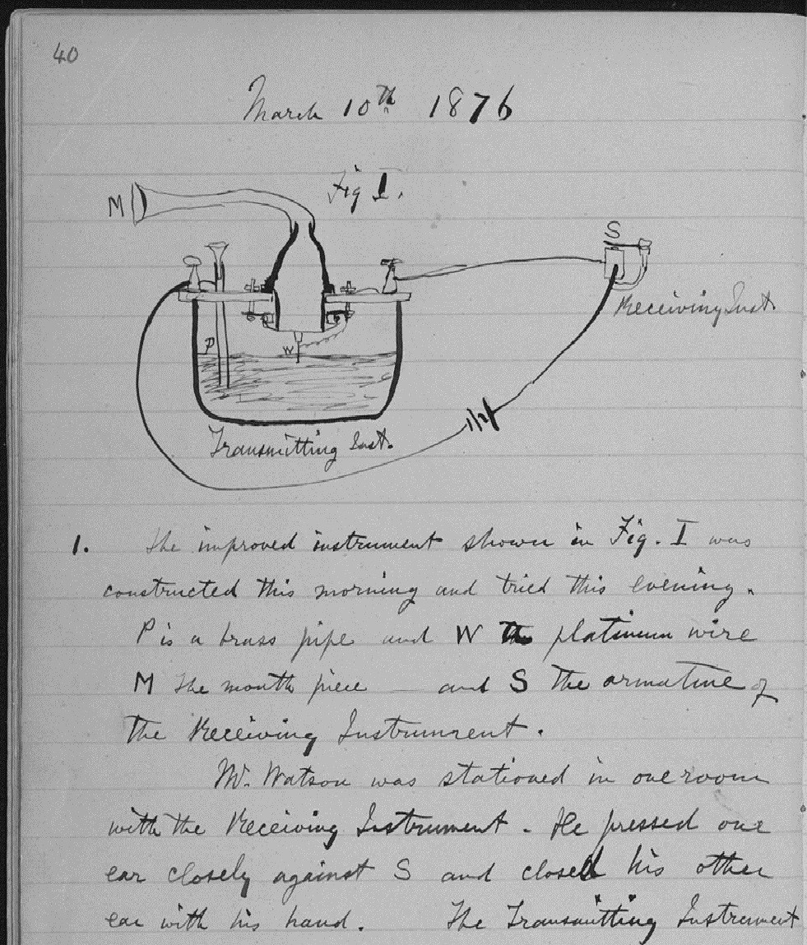
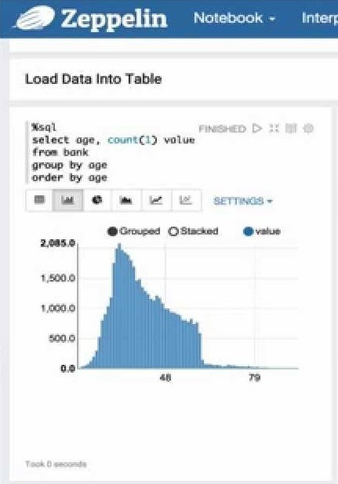
What is a “Notebook”?
Pen and Paper
Notebook

Slide 30
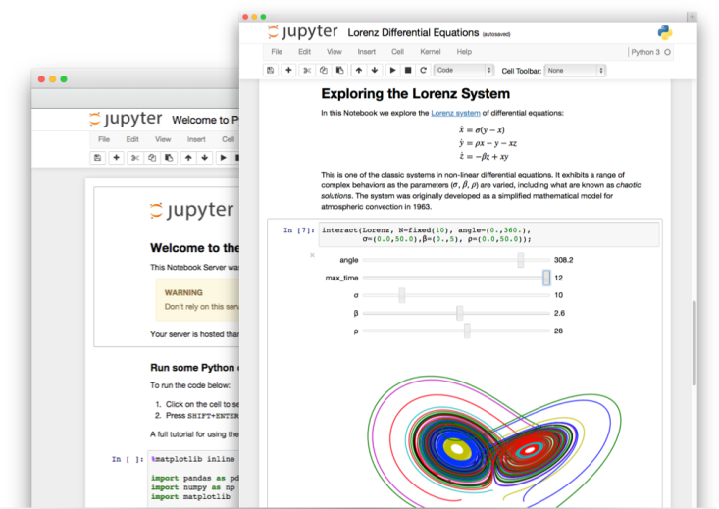

Web-Based Notebooks
Notebooks:
“interactive computational environment, in which you can combine code execution, rich text, mathematics, plots and rich media”
Zeppelin
Jupyter
Data Scientist &
Notebooks
10

Slide 31

Data Scientist - Current Challenges and Pain Points
Rigid toolset
Have to choose one and only one approach
Cannot easily connect all of the capabilities required
Difficult to navigate between the various tools used
Fragmented and time consuming
Using multiple disjoint environments
Separate on-ramp/community for each tool/environment
Does not have meta data or data lineage
Analytical Silo
Difficult to maintain and version control project assets
Limited means of collaborating with teams
Results are difficult to share
Notes:
Data science is a field that is filled with opportunity specially for improvements in tooling and processes. It’s an exciting time, with new open source algorithms and libraries released every week - but this fast moving innovation also brings challenges for organizations to keep up with and manage these fast moving infrastructures and tools.
Typically Data Scientists and data science teams today have many pain points that they must deal with on a daily basis. Many companies struggle with which programming language to use – should they standardize on just one, like R or Python? Or should they let employees use any language of their choice? Which scalable implementations should they use? How will they stitch all of this together into a flowing system for getting data science to work for the organization?
Furthermore, most data science teams don’t know their data’s lineage and lack metadata or any formal way to govern their projects. Often times projects are just hacked together without any real thought into the longer term consequences of their decisions.
And once a data product has been developed, data scientists must find a way to share it with others. They need an easy way to create visualizations and dashboards for business analysts and line of business users – deploying as a web service or simply even sharing the analysis with other data scientists. These barriers around sharing and deployment can be major hurdles preventing organizations from deriving value from the analysis of their data assets.

Slide 32

IBM Data Science Experience
ALL YOUR TOOLS IN ONE PLACE
IBM Data Science Experience is an environment that brings together everything that a Data Scientist needs. It includes the most popular Open Source tools and IBM unique value-add functionalities with community and social features, integrated as a first class citizen to make Data Scientists more successful.
datascience.ibm.com

Slide 33



Data Science Experience
Learn
Create
Collaborate
Built-in learning to get started or go the distance with advanced tutorials
The best of open source and IBM value-add to create state-of-the-art data products
Community and social features that provide meaningful collaboration
External URL: http://datascience.ibm.com
Internal ZACS Page: https://ibm.biz/BdrDv5
Notes:
Now let’s dig into the IBM Data Science Experience (DSX). DSX is a single platform to Learn, Create, and Collaborate – the 3 pillars of a successful data science organization. With DSX we are making it easier for data scientists and data science teams to collaborate and learn new skills and technologies from the fast moving data science profession.
Users can join the 400,000+ registered users on Big Data University to take courses and administer custom curriculum on Data Science. DSX also provides freely available datasets, code samples, tutorials and articles from the data science community, thereby making it easier for data scientists to learn in-context.
We also know that a data science team isn’t going to standardize on a single technology or tool – data scientists need an open and integrated platform that brings all of their tools in one place. DSX brings together the best of breed open source tooling such as RStudio, Spark, and Python in an integrated environment along with IBM value-adds, such as a managed Spark service and data shaping capabilities all in a secure and governed way.
Users can collaborate in DSX with ease -- you can manage project assets and user collaboration through built-in social features for sharing, forking, and reusing assets. These built-in collaboration features can really help boost team productivity and managing projects across their lifecycle.

Slide 34
Core Attributes of the Data Science Experience
IBM Data Science Experience
Community
Open Source
IBM Added Value
Find tutorials and datasets
Connect with Data Scientists
Ask questions
Read articles and papers
Fork and share projects
Code in Scala/Python/R/SQL
Jupyter Notebooks
RStudio IDE and Shiny
Apache Spark
Your favorite libraries
IBM Machine Learning*
SPSS Modeler Canvas*
Prescriptive Analytics - DOcplexcloud
Projects and Version Control
Managed Spark Service
Powered by IBM Watson Data Platform
* Closed beta
Notes:
The new offering IBM Data Science Experience brings together everything that a Data Scientist needs today to be more successful. It is based on three concepts:
Community: A Data Scientist needs to be updated with the latest news from the Data Science Community. There are plenty of new Open Source packages, libraries, techniques and tutorials available every day. A good Data Scientist follows the most important sources and shares their opinion and experiments with the community. We are bringing this into the user interface of DSX – so you don’t really have to open up a bunch of different bowser tabs to do your research, you can do it right inside the tool.
Open Source: Today there are companies that rely on open source for data science. Open source has become so mature that is directly competing with commercial offerings. We provide the best of open source within DSX, such as Spark, RStudio, Jupyter, and more.
Value Add: We improve open source by adding some capabilities from IBM. Data Shaping for example takes 80% of the Data Scientist’s time. We are providing tools with visual GUI to help users better perform this task. You are also able to execute Spark jobs on our managed Spark Service in Bluemix from within the DSX.

Slide 35
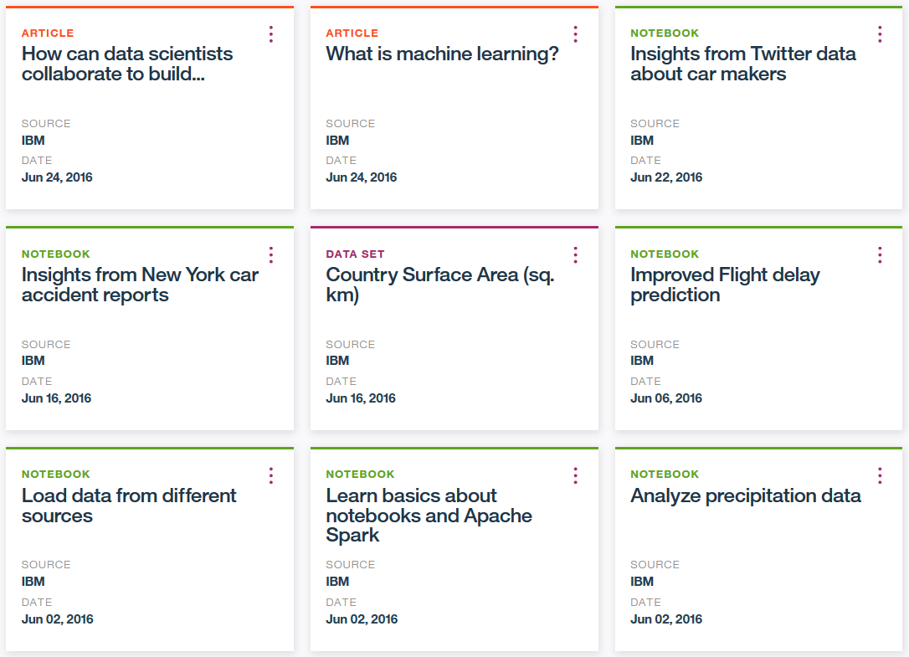
Community Cards provide in-context learning for users

Slide 36
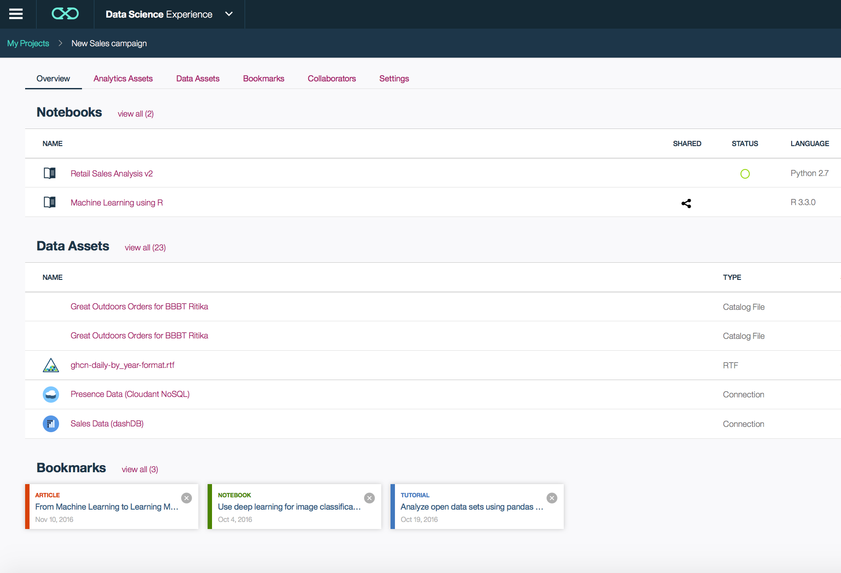
Collaborate Using Projects
Notes:
Projects are a core component of our Watson Data Platform. Projects make collaboration easier – they are a collaborative entity with data services, connections, object storage, notebooks and more. Once you create a new project within Data Science Experience, you are presented with an interface like the one shown in the slide, it is a project management framework where you can view/create/add/modify/remove various assets. A framework like this can play a huge role in bringing down siloes across the various data personas and promote collaboration.

Slide 37
Hands - on Labs https://github.com/joshishwetha/dsx-spark

